Slide 1

INTRODUCTION TO ARTIFICIAL INTELLIGENCE
Lyernisha s r
Lecturer, fict

Slide 2
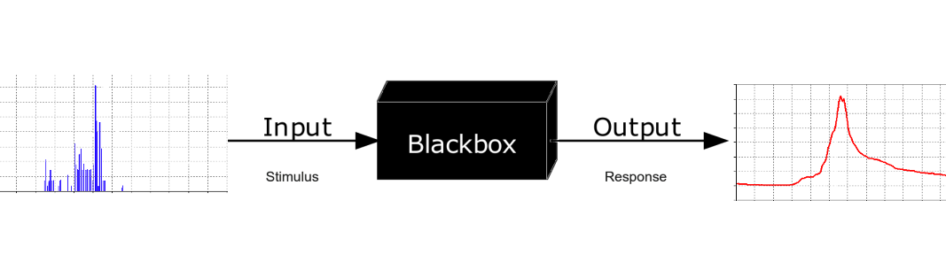
“Black-Box” model

Slide 3
The “Black-Box” model of computer systems
A black box is a system which can be viewed in terms of its inputs and outputs (or transfer characteristics), without any knowledge of its internal workings.
Its implementation is "opaque" (black)
The term can be used to refer to many inner workings, such as the ones of a transistor, an engine, an algorithm, the human brain, or an institution or government.
In computer programming and software engineering, black box testing is used to check that the output of a program is as expected, given certain inputs.
The term "black box" is used because the actual program being executed is not examined.

Slide 4
Black box Model of Computing
Computing model will be the underlying processing framework that produces the output with respect to the input given.
There will be several processing models suitable for a system or an application
Selecting the best model depends upon the goal to be achieved or task to be accomplished.
Computing models are often called as Black box models
This is because , to any user ,the input to and output from the system will only be known.
The internal structure and processing ( model) will be hiding from the user's perspective.

Slide 5
Problem Categorization in view of Black box model of computing
Computing models are often called as ‘ Black Box Model ‘ because to any user of a computing system or application, the input and output will be known but not the internal computations /processing frameworks / system model will not be visualized.
In view of black box model of computing , AI problem types are categorized into the following categories.
Problem Type 1 : Input Missing
Problem Type 2 : Model Missing
Problem Type 3 : Output Missing

Slide 6
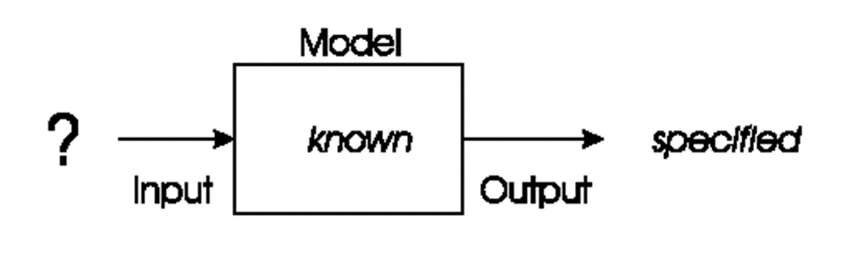
Problem type 1: Input Unknown
In these types of problems, we will have a model of our system and a specified goal / output but seek inputs that correctly give us that goal.
The task is to choose an input or a sequence of inputs which exactly gives the specified goal.

Slide 7
Problem Type 1- Input Unknown Example: Planning & Optimization Problems
PLANNING
The Planning in artificial intelligence is about the decision-making tasks performed by the robots or computer programs to achieve a specific goal.
The execution of planning is about choosing a sequence of actions with a high likelihood to complete the specific task/goal.
To select all inputs (decide the inputs) → Planning is needed.
OPTIMIZATION
Optimization deals with finding the best one with least error from the set , among all feasible existing set of elements in the considered set .
It is the process of finding an outcome with the most cost effective or highest achievable performance under the given constraints, by maximizing desired factors and minimizing undesired ones.
If the problem/ task is to find all possible inputs/events that leads to a particular goal/ or produce a specific output, then that is a planning problem.
If the inputs are known and the task is to find /select the best input among all inputs , then it is an optimization task/problem

Slide 8
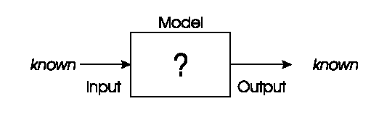
Problem type 2: Model Unknown
In these types of problems, we will have inputs to our system and a specified goal / output but seek a model that correctly produce an output for the corresponding input given.
The task is to choose a best model which exactly gives us the correct output for the input given.

Slide 9
Problem Type 2- Model Unknown Example: Modelling & Prediction Problems
Predictive modeling, is a mathematical technique which uses statistics for prediction.
A predictive model automatically classifies or matches the input to its appropriate matching output.
Machine Learning Models like neural networks, decision tree etc.. are example for models.
So here the task is to select the best model suitable for the considered scenario.

Slide 10
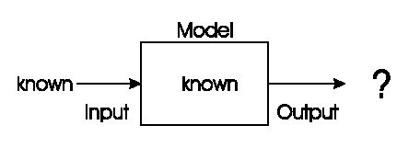
Problem type 3- Outputs Unknown
We have a given model and wish to know the outputs that arise under different given input conditions.
The task is to find the results/ correct outputs/solutions to the given input/problem when processed by a model
This output unknown problem could be for:
Recognition,
Prediction,
Simulation,
Fault Diagnosis

Slide 11
Problem Type 3- Output Unknown Example: Prediction/ Recognition Problems
Prediction problems deals with the finding the outcome /solution of a new data /input which’s outcome /output is not currently clear or known. It’s an important machine learning task.
To make predictions on new inputs , prediction algorithms study similar historical data.
In order to make predictions on a new piece of input data , the system has to recognize all the hidden features & relationships of that data item with respect to similar previous historical data.
Pattern recognition is the process of recognizing patterns by using a Machine Learning algorithm. This is usually done or applied for carrying out various machine learning tasks like classification/prediction.
Examples
Determine the next move/ best action in a marketing campaign.
Finding a transaction that is occurring or occurred is fraudulent or not.
Fingerprint identification, Computer vision etc.

Slide 12
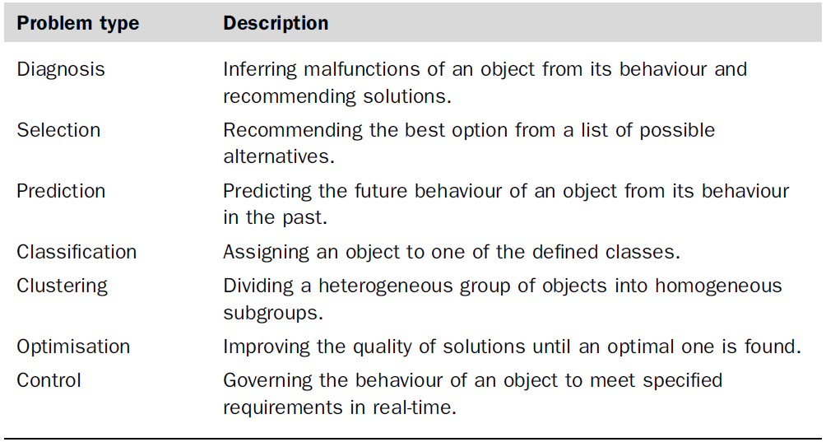
Problem types

Slide 13
Thankyou

